Slide 1
Satellite Data for Health & Air Quality Applications
NASA Goddard Space Flight Center
Bryan Duncan
January 31st, 2017; SatSummit, Washington, DC
Notes:
Tell you a bit about NASA Science.

Slide 2
1 of Every 9 Deaths Related to Air Pollution (WHO)
US $5 Trillion in Welfare Losses (World Bank)
Goal 3 – Good Health & Well Being
Target 3.9: Indicator 3.9.1
Mortality rate attributed to household and ambient air pollution (mean annual levels of air pollution - fine particulate matter [PM_{2.5}])
Goal 11 – Sustainable Cities & Communities
Target 11.6: Indicator 11.6.2
Annual mean levels of PM_{2.5} in cities (population weighted)

Slide 3
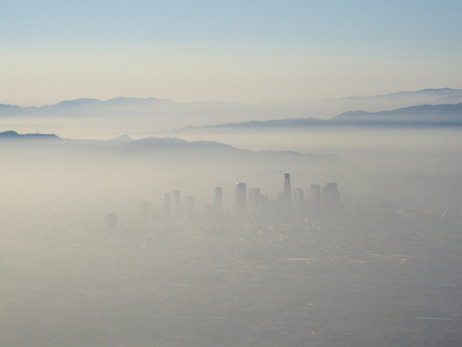
Satellites Provide a “God’s-Eye” View of the Earth
Spatial coverage is the primary advantage of satellite data
Los Angeles smog
Los Angeles from Space
NASA Skylab
1973

Slide 4
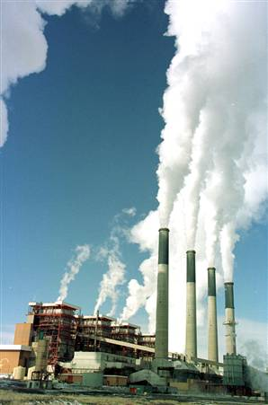
Satellite measurements vs. surface measurements
Satellites measure an “atmospheric column” (molecules/cm²)
Pollution
plume
Surface stations measure emissions and “Nose-level” concentrations

Slide 5
Nitrogen dioxide (NO₂) measurements
Satellite vs EPA surface data?
Houston, Texas
NASA Satellite EPA Surface Data
Time
Techniques to convert satellite data to familiar quantities are improving over time!

Slide 6
Application: Health Studies of Exposure
The satellite data offer increased statistical power for complete exposure assignments that strengthen inferences of their relations with health outcomes
Annual Average
PM2.5 (µg/m³)
WHO Interim Targets
Annual
Brauer, M., et al., Ambient Air Pollution Exposure Estimation for the Global Burden of Disease 2013, Environ. Sci. & Tech., 50 (1), 79-88, doi: 10.1021/acs.est.5b03709, 2016.

Slide 7
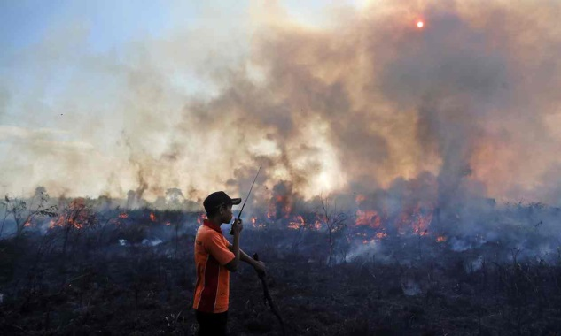
Application: Mitigation Strategy Development
~100,000 Excess Deaths
Used satellite data for short and long-term mitigation strategy development
Aerosol Index
Aerosol Optical Depth
Koplitz, S. N., et al., Public health impacts of the severe haze in Equatorial Asia in September-October 2015: Demonstration of a new framework for informing fire management strategies to reduce downwind smoke exposure, Environ. Res. Lett., doi: 10.1088/17489326/11/9/094023, 2016.

Slide 8
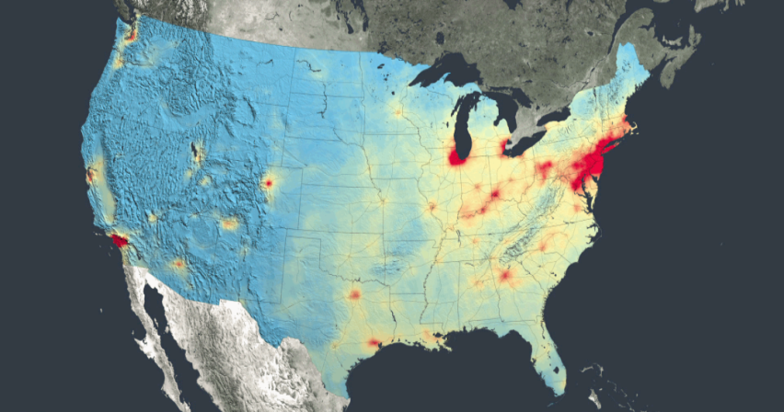
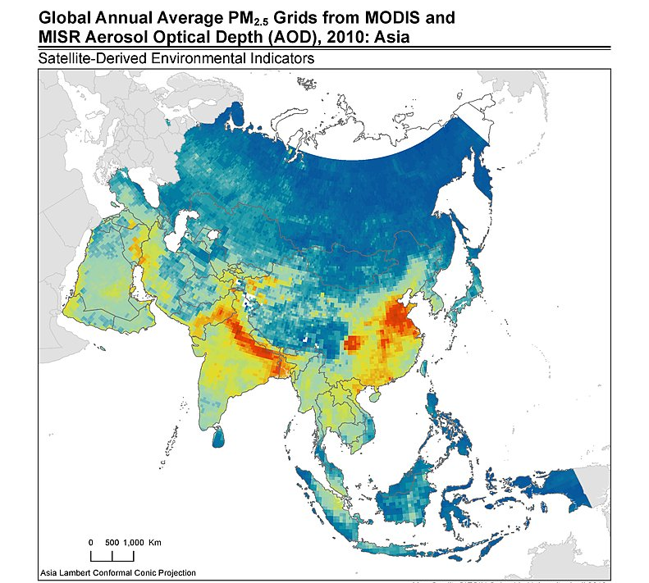
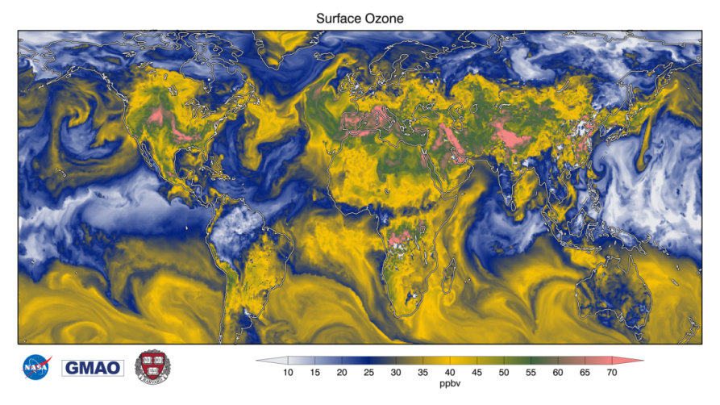
Application: Societal Benefit
Satellite-Based Health Air Quality Index
Bryan Duncan, ……..
NASA Satellite NO₂
NASA Partnership with UNICEF:
Text alerts of impending poor air quality, such as to asthmatic children.
Multi-Satellite: AOD → PM_{2.5}
NASA GEOS-5 Model: Ozone

