Slide 1
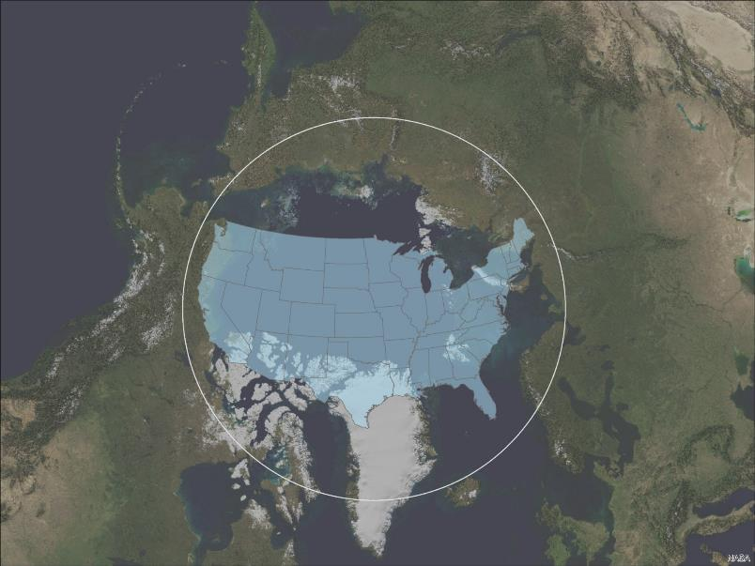
SCALE

Slide 2
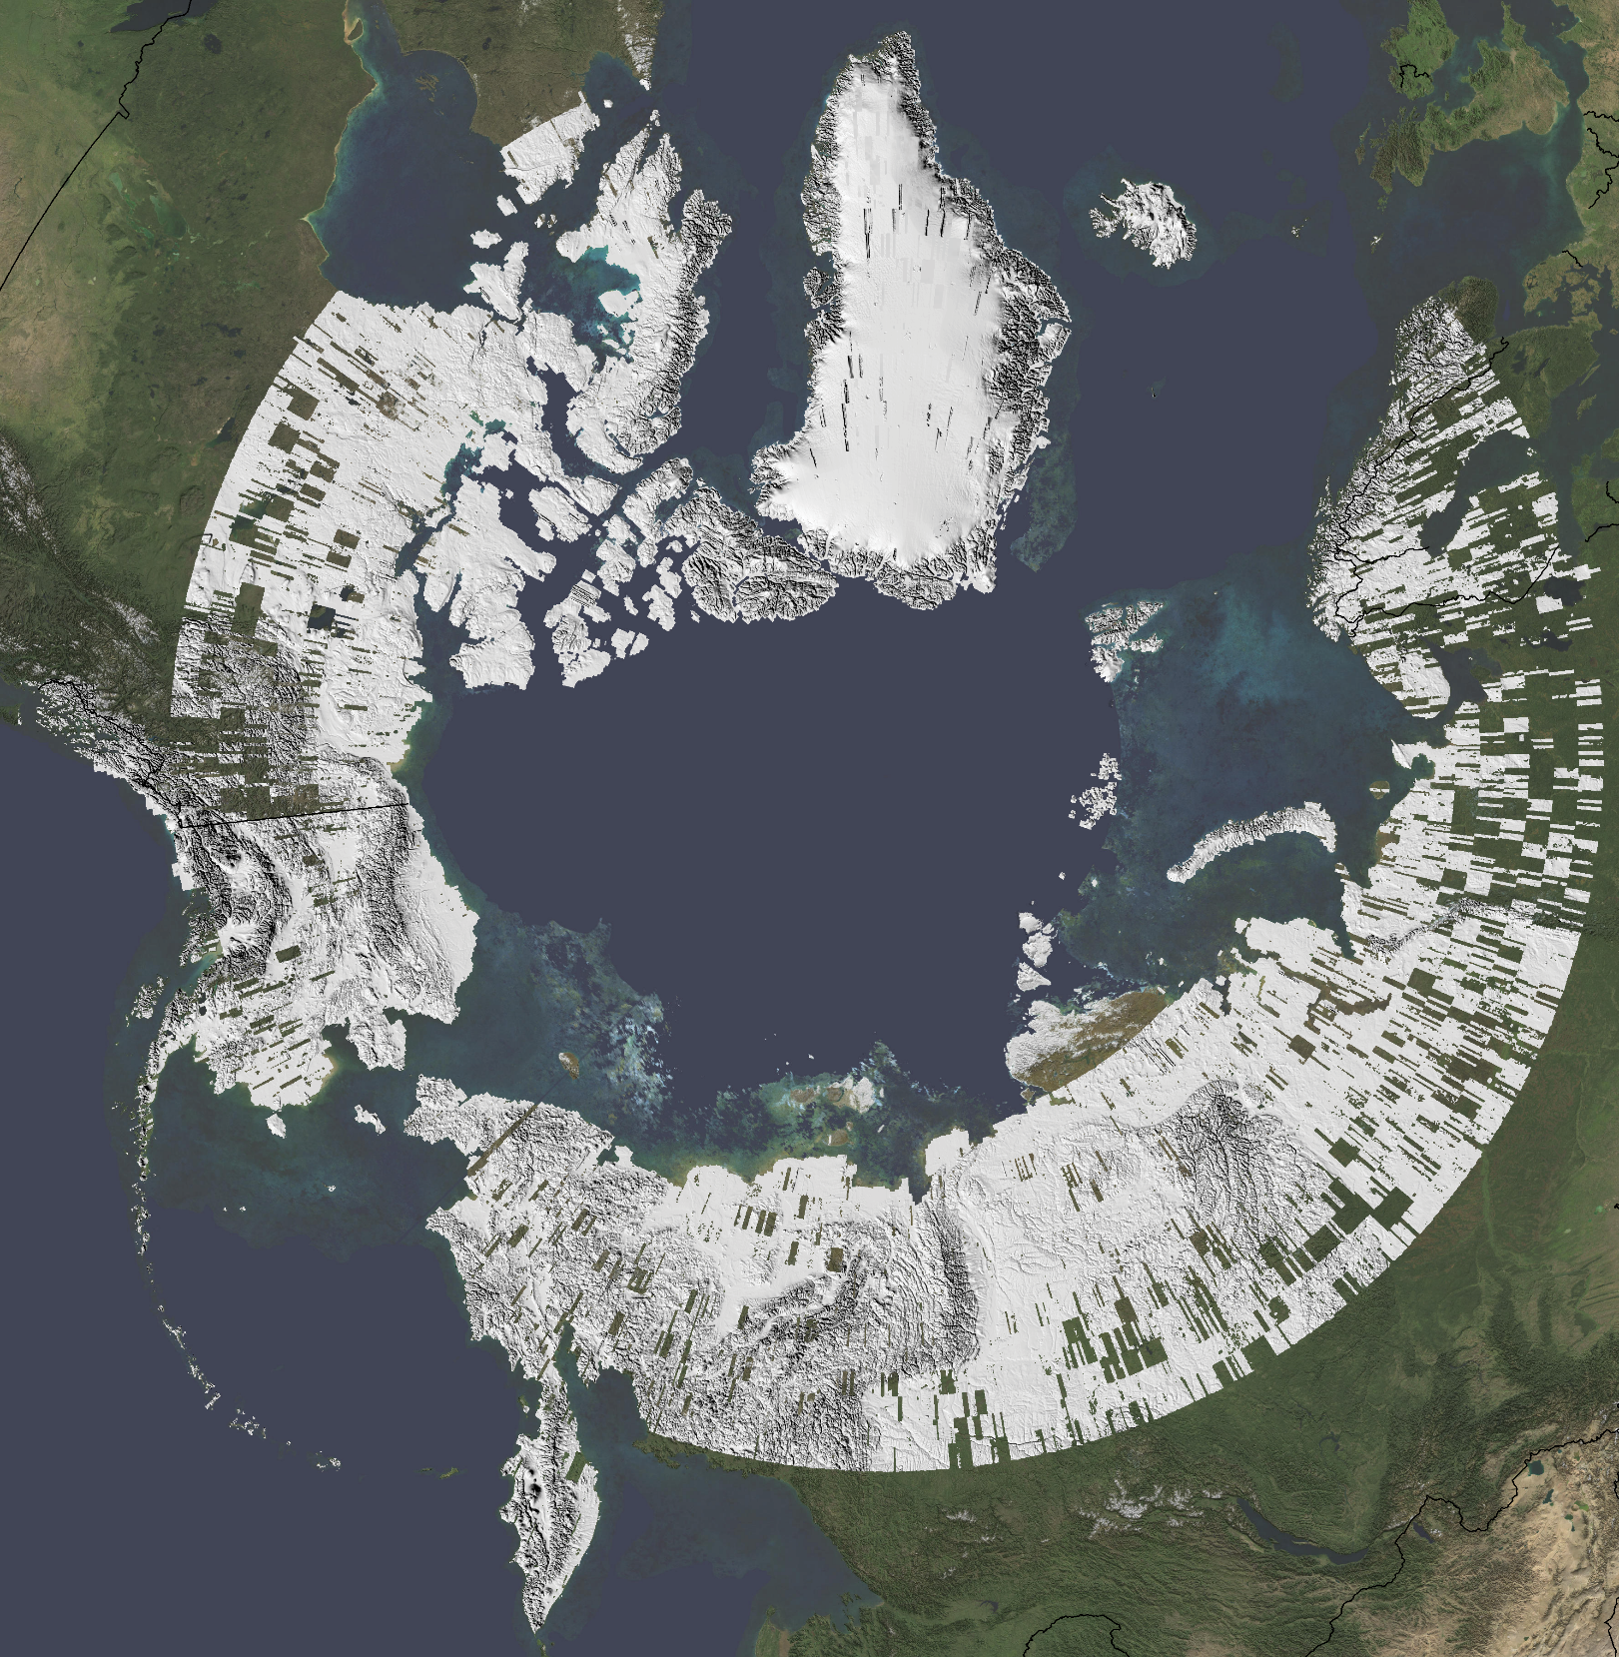
Current 8m resolution Coverage
Current 8m Coverage

Slide 3
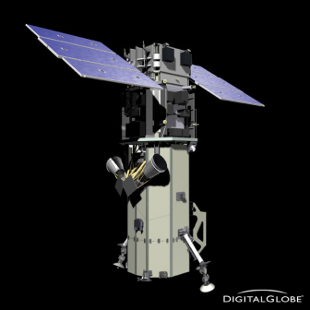
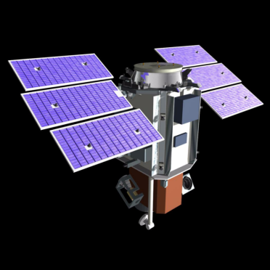
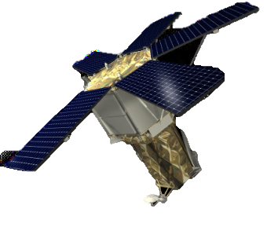
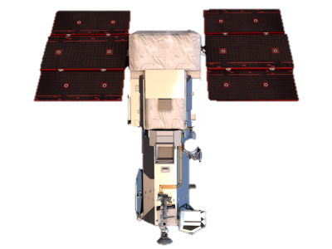
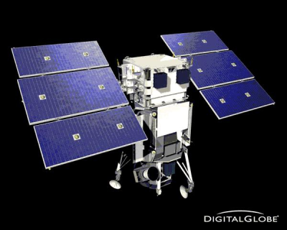
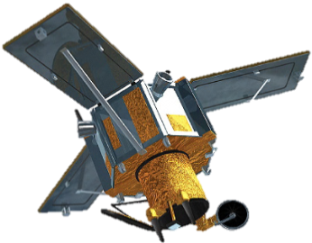
Digital Globe Satellites Used for the ArcticDEMs
GeoEye
QuickBird
WorldView-2
IKONOS
WorldView-3
WorldView-1

Slide 4
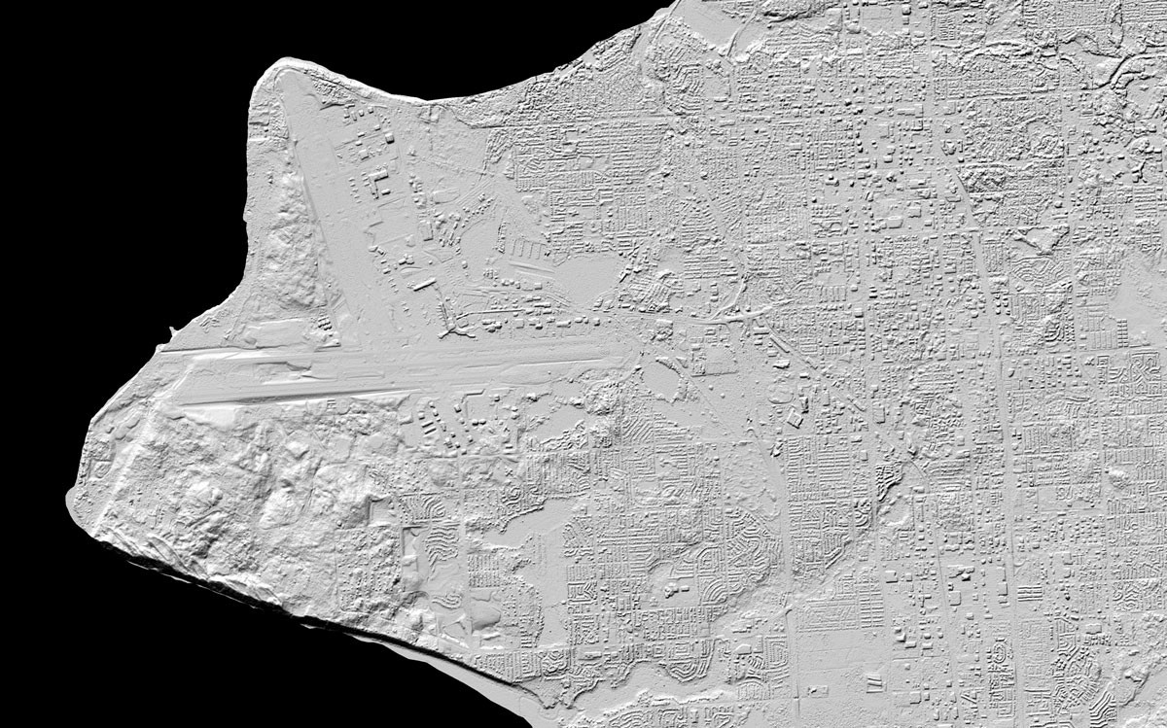
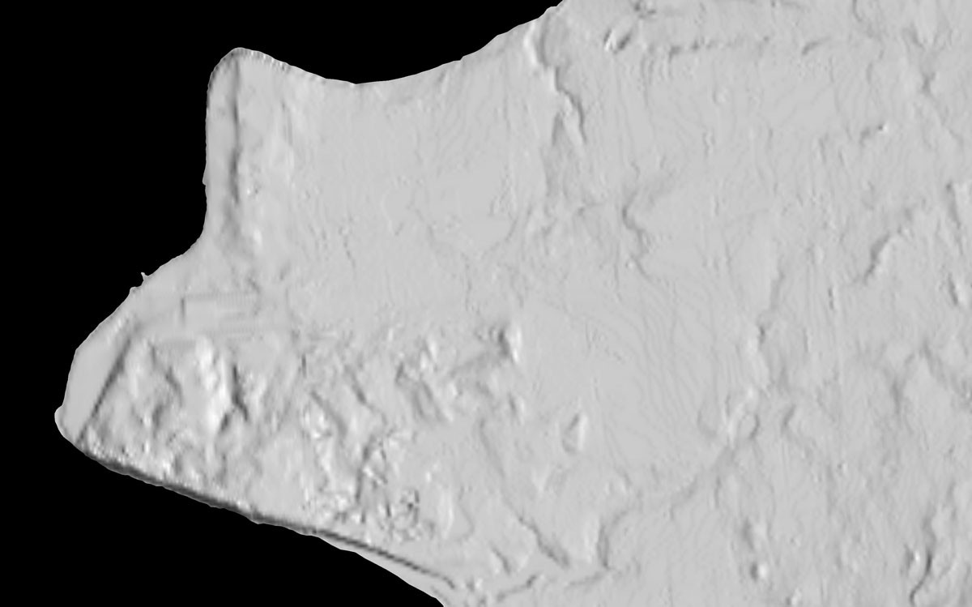
Anchorage, AK
Notes:
Anchorage Before After

Slide 5
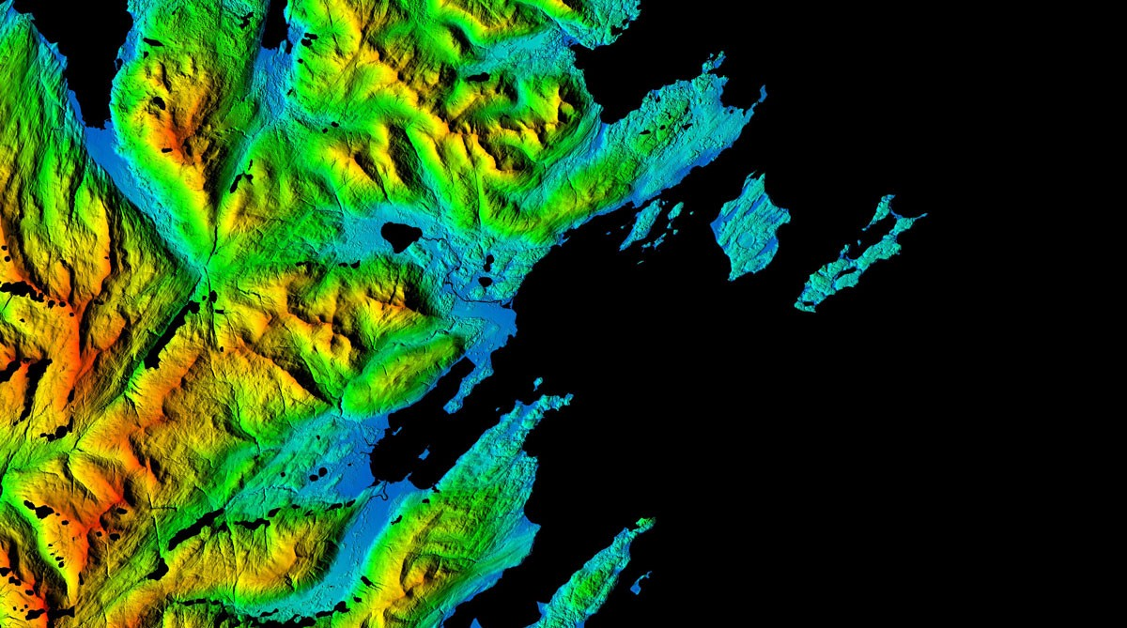
Kodiak Island, AK
Notes:
This Arctic digital elevation model image centers on Kodiak Benny Benson State Airport, a public and military airport located five miles southwest of the city of Kodiak. The image highlights the rugged relief surrounding the three runways of the airport and clearly depicts vegetation, buildings, coastal features and the drainage network of the area. Elevation transitions smoothly from blue (low elevations) to green (medium to higher elevations) to red (peaks).

Slide 6
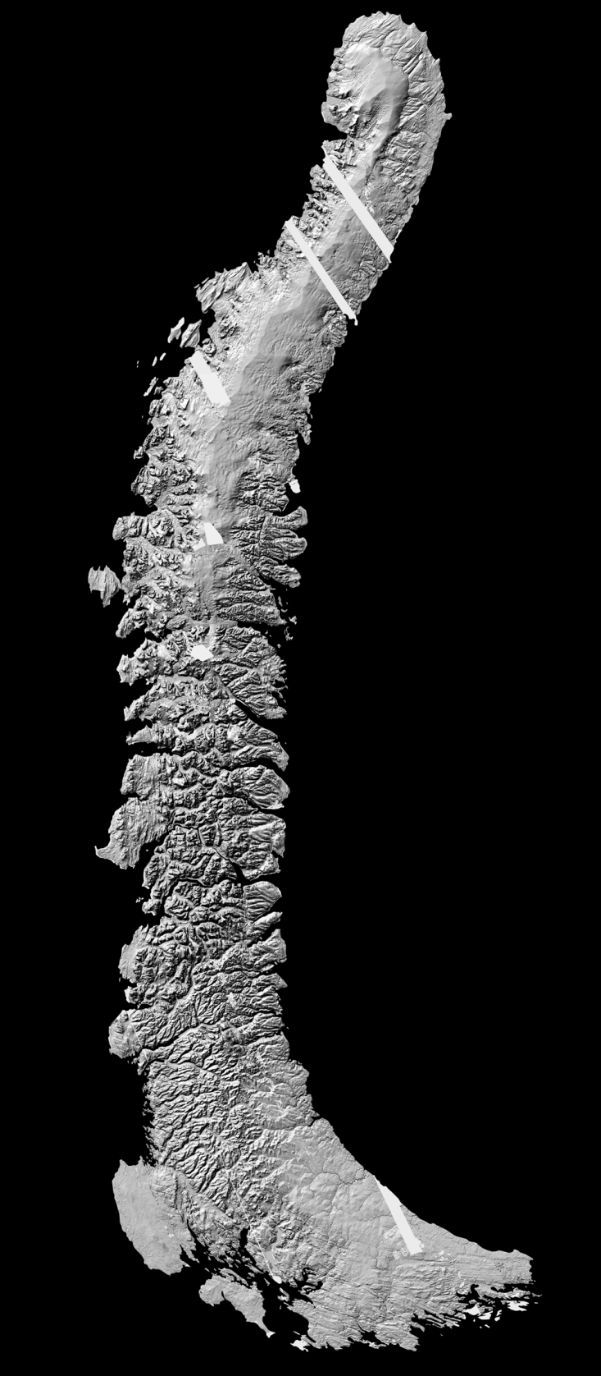
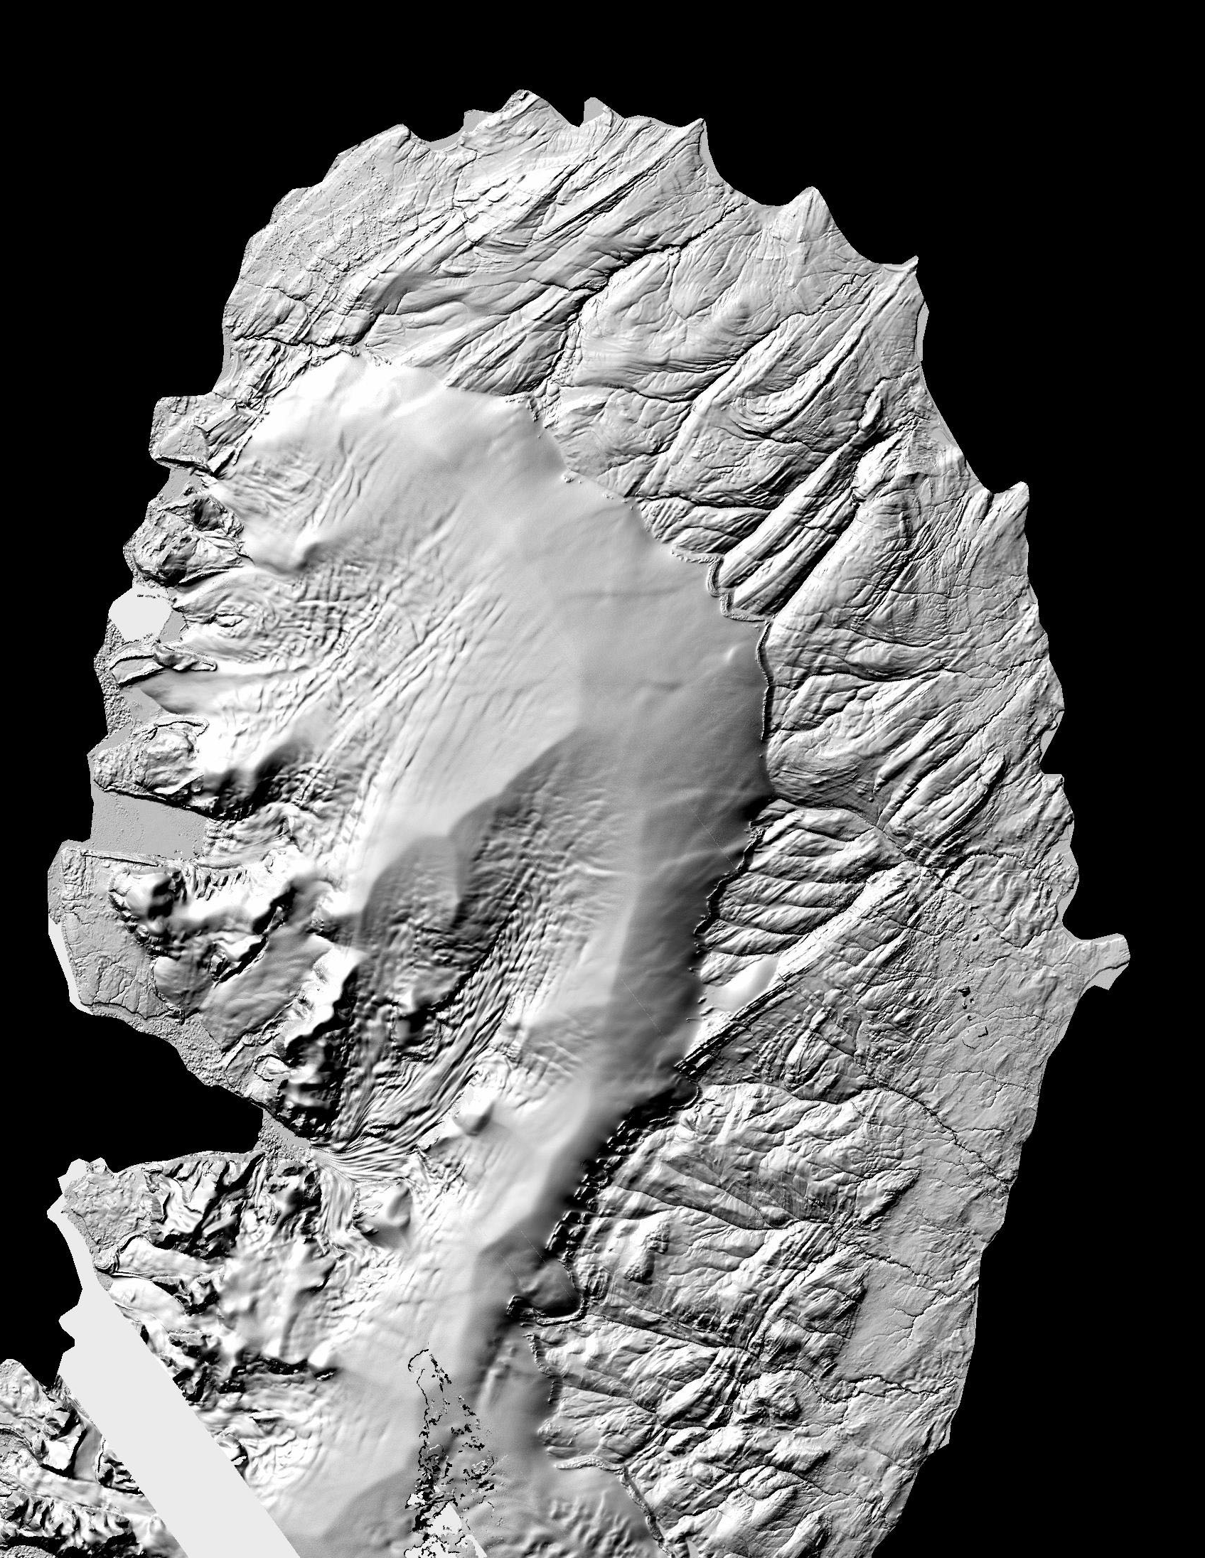
Novaya Zemlya, Russia

Slide 7
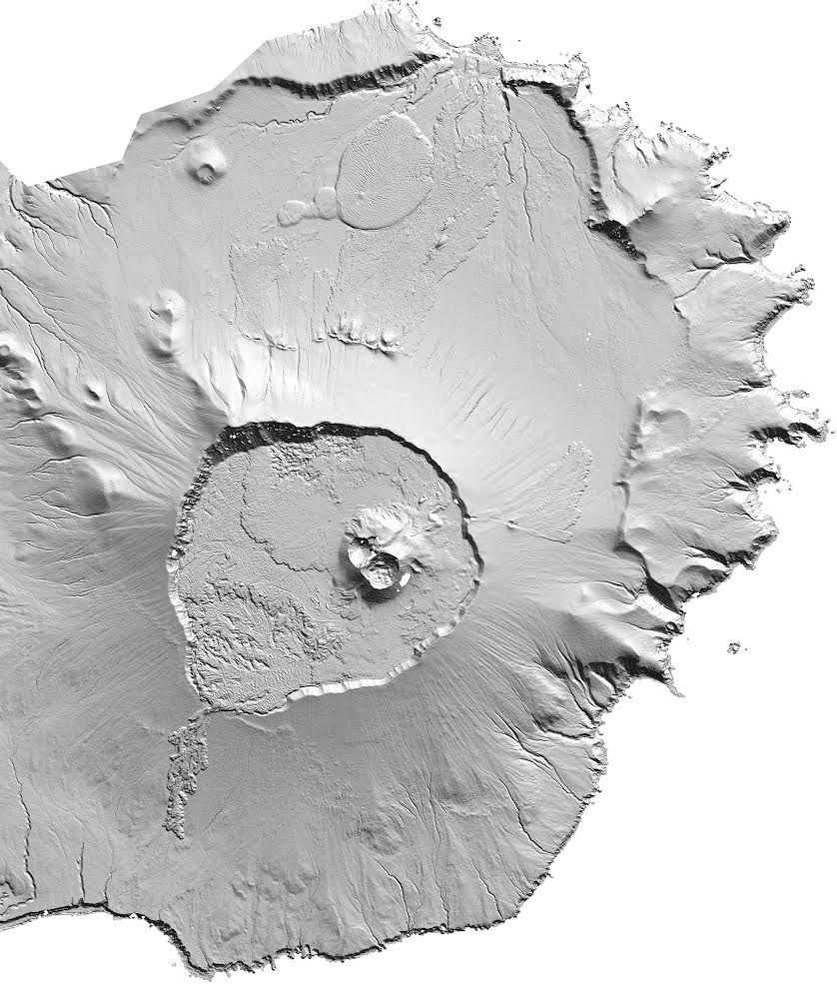
Unaska Island, Alaska
Notes:
Unaska Island

Slide 8
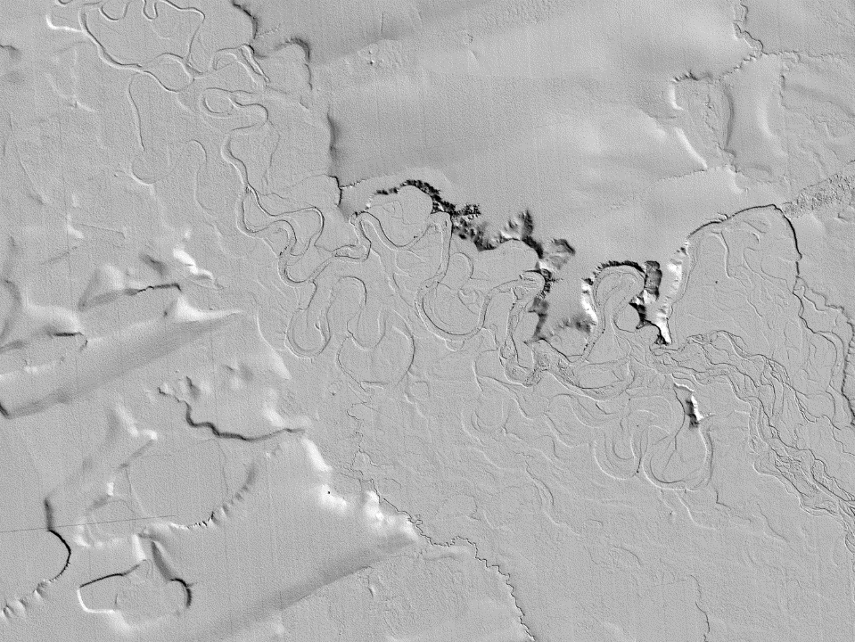
Thermokarst collapse, Kuparuk watershed, Alaska

Slide 9
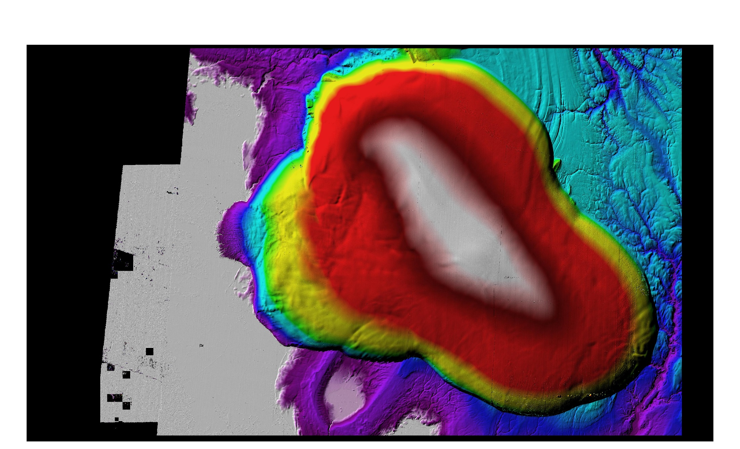
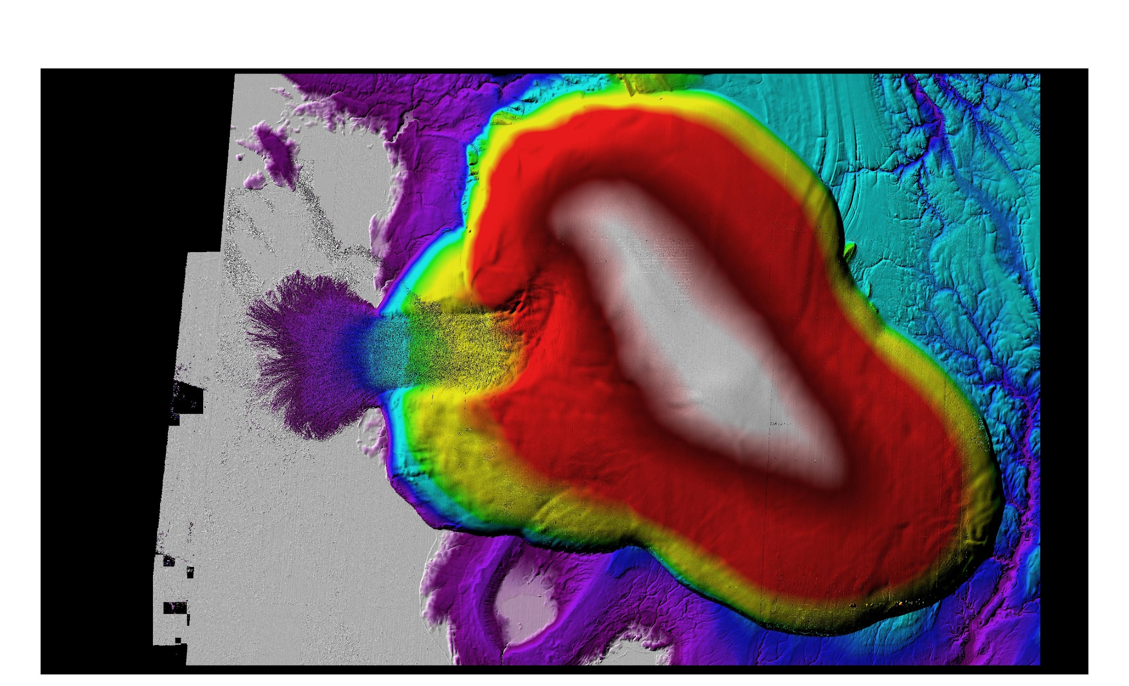
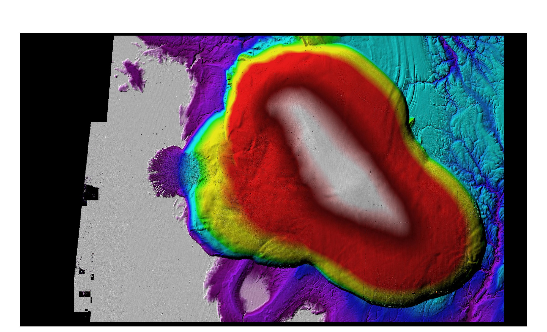
Russian High Arctic Ice Changes
Russian High Arctic Ice Changes
Russian High Arctic Ice Changes
March 2014
March 2016
March 2015
Vavilov Ice Cap
Vavilov Ice Cap
Vavilov Ice Cap
Mass loss: -0.84 km³/yr

Slide 10
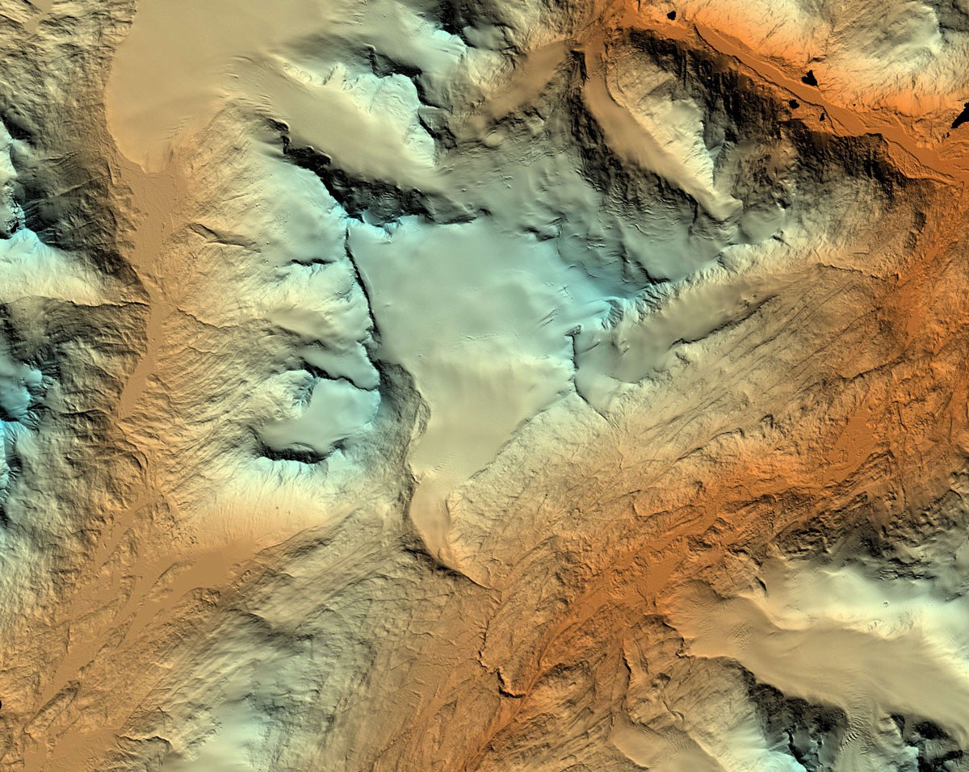
Wolverine Glacier , AK
Notes:
Wolverine Glacier is a valley glacier in the coastal mountains of south-central Alaska’s Kenai Peninsula. For climate change monitoring, satellite imagery can be collected and DEMs produced at regular intervals — weekly, monthly or annually — to observe and document changes as they occur. Elevation transitions smoothly from dark blue (low elevations) to light blue (medium to higher elevations) to red (highest elevation).

